Slide 1

CAPSTONE PROJECT: Flight Delay Prediction using Deep Learning
Presented By: K. Venkata Sai Mrudula
Student Name: K . Venkata Sai Mrudula
College Name: Andhra Loyola institute of engineering and technology
Department: Cse (ai & ml)
Email ID: mrudulakakaraparthi@gmail.com
AICTE Student ID: AINSI_113640

Slide 2
OUTLINE
Problem Statement
Proposed System/Solution
System Development Approach
Algorithm & Deployment
Result
Conclusion
Future Scope
References

Slide 3
Problem Statement
Air travel delays cause significant economic losses and lead to passenger dissatisfaction. Identifying the root causes and predicting delays in advance is challenging due to the complex nature of flight operations and external factors such as weather and air traffic congestion.
Flight delays disrupt airline operations and impact scheduling efficiency. Traditional methods often fail to predict such delays accurately and proactively. Therefore, there is a need for a smart, data-driven solution that can analyze historical data and forecast delays in advance to support better planning and decision-making.

Slide 4
Proposed Solution
The proposed system aims to predict whether a flight will be delayed or not using a deep learning-based classification approach. The goal is to assist airlines in making proactive decisions and improve passenger experience by identifying delay risks in advance.The solution will consist of the following components:
Data Collection:
Collected historical flight data including: Flight date , Airline carrier, Origin and destination airports, Scheduled departure and arrival times, Distance and actual arrival delay status
Data Preprocessing:
Removed records with null or irrelevant values
Categorical features such as Carrier, Origin, and Destination were encoded using Label Encoding
Target variable (ArrDelay) was transformed into binary class:
Delayed: if delay > 0 minutes
On-time: if delay ≤ 0 minutes
Data was normalized to improve training performance
Deep Learning Model
Built a classification model using ANN with ReLU activations, dropout layers, and sigmoid output.
Trained using binary crossentropy loss and optimized with the Adam optimizer.
Deployment:
Developed in Python using TensorFlow/Keras.
Can be integrated into dashboards for airlines or airport operators for real-time prediction.
Evaluation:
Model evaluated using accuracy; achieved high performance in classifying delays.
Visualizations include accuracy score, confusion matrix, and delay trend charts.

Slide 5
System Approach
Libraries Used:
pandas, numpy – for data loading and preprocessing
seaborn, matplotlib, plotly – for data visualization
scikit-learn, TensorFlow/Keras – for building and evaluating models
Technologies:
Programming Language: Python
Environment: Jupyter Notebook
Methodology: Deep Learning (Artificial Neural Network)
System Requirements:
OS: Windows/Linux
RAM: Minimum 8 GB
Processor: i5 or higher
Python Version: 3.7+
Required Packages: TensorFlow, Keras, pandas, scikit-learn, matplotlib

Slide 6
Algorithm & Deployment
Algorithm Selection:
Deep Neural Network (ANN) chosen for modeling due to its ability to capture nonlinear relationships in the data.
Input Features:
Flight Date, Carrier, Origin, Destination, Scheduled Time, Distance, etc.
Training Process:
Data normalized and split into training and testing sets.
Model trained using Keras with ReLU activation and dropout regularization.
Prediction:
Predicts delay in minutes. Uses regression-based output.

Slide 7
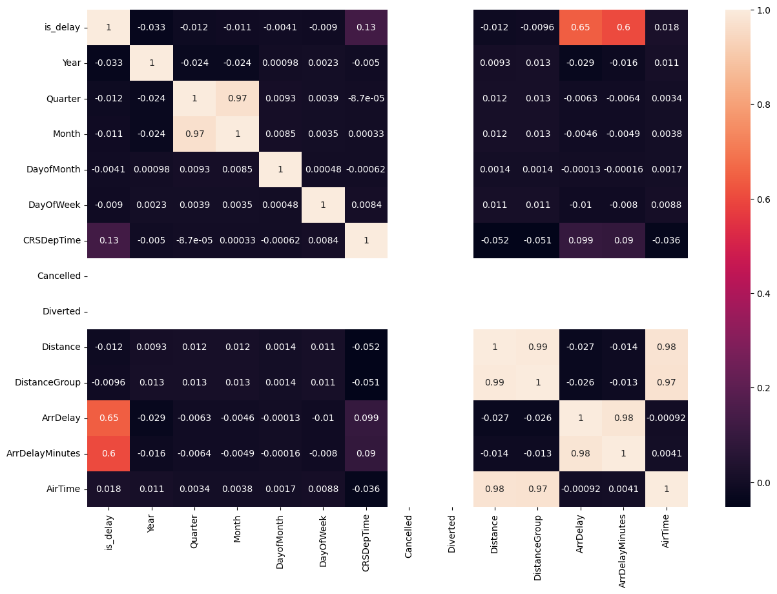
Result
Model Performance:
The deep learning model (ANN) was trained and tested on historical flight data.
Model evaluation was performed using the accuracy metric.
Achieved Result:
Accuracy: 0.98
The model successfully classified delayed vs on-time flights.
Visual Output:
Confusion Matrix for evaluating prediction distribution

Slide 8
Conclusion
A deep learning-based approach using an Artificial Neural Network (ANN) was implemented to classify flight delays.
The model demonstrated high accuracy, effectively distinguishing between delayed and on-time flights.
This predictive system can support airlines and airports in proactive planning and improving passenger satisfaction.
The project highlights the value of historical data and machine learning in addressing real-world aviation challenges.

Slide 9
Future scope
Real-time Data Integration: Incorporate live weather, air traffic, and operational data for dynamic predictions.
Multi-class Classification: Predict not only delay occurrence but also the severity (e.g., short, moderate, long delay).
Web-based Deployment: Develop a dashboard for airline operators to use predictions in day-to-day operations.
Cross-Airline Scalability: Extend the model to work across different airlines and international flights.
Optimization: Fine-tune model architecture and training parameters for higher precision and generalization.

Slide 10
References
Dataset: flight_delay_predict.csv — containing historical flight records for model training and evaluation.
Libraries Used:
TensorFlow/Keras – Deep Learning Framework
scikit-learn – Data Preprocessing and Evaluation
pandas, numpy – Data Handling
matplotlib, seaborn, plotly – Data Visualization
Development Tools: Python 3.7+, Jupyter Notebook.
Official Documentation:
TensorFlow: https://www.tensorflow.org
scikit-learn: https://scikit-learn.org
GitHub Repository: https://github.com/KVSMrudula/Flight_Delay_mrudula

Slide 11
Thank you

